Slide 1
AIY BUILD NIGHT
AIY BUILD NIGHT
Do-It-Yourself Artificial Intelligence

Slide 2
Welcome to AIY Build Night!
You will build an artificially intelligent speaker or camera. This guide will help you get started on your journey with the AIY kit. Here’s what you can expect:
Use this guide to assemble your kit.
Navigate to our GitHub repository for additional laptop setup to connect to your kit!
The GitHub repository is here: https://github.com/HarvAce/aiy-build-night
Get your kit working, ask for help if you need it.
Check out the examples folder on Github for examples of how to customize your kit!
Experiment and see what your kit can do!
Tips:
When opening and closing connector latches, use as little force as possible to reduce the risk of damaging the latch.
After inserting a cable, be sure to verify it is secure before continuing.
When installing the standoffs, significant force may be required. If you feel you are applying too much force and cannot insert the Standoffs, you can use pliers or another tool to squeeze the end of the standoffs gently while inserting.
We can’t wait to see what you build! Have fun! Happy learning!

Slide 3
WE NEED SOME PARTS?

Slide 4
AIY Voice Kit
1. Voice HAT Accessory Board
2. Voice HAT Microphone Board
3. Plastic Standoffs
4. 3” Speaker
5. Push Button
6. 4-Wire Button Harness
7. 5-Wire Daughter Board Cable
8. External Box
9. Internal Frame

Slide 5
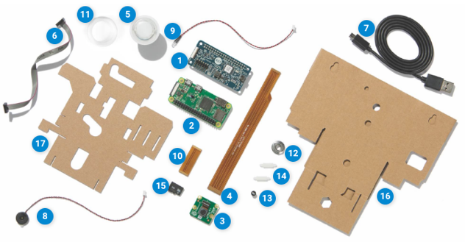
AIY Video Kit
1. Vision Bonnet
2. Raspberry Pi
3. Raspberry Pi Camera V2
4. Long Flex
5. Push Button
6. Button Harness
7. Micro USB Cable
8. Piezo Buzzer
9. Privacy LED
10. Short Flex
11. Button Nut
12. Tripod Nut
13. LED Bezel
14. Standoffs
15. Micro SD Card
16. External Box
17. Internal Box

Slide 6
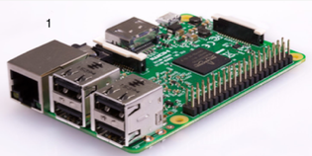
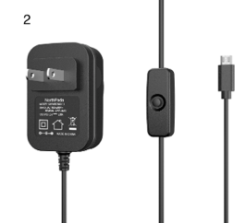
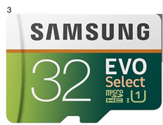
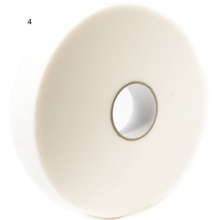
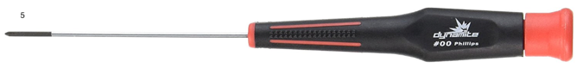
AIY Kits - Additional Parts and Tools
1. Separate Raspberry Pi 3 (AIY Voice only)
Separate 2.1A Power Supply (AIY Voice Only)
MicroSD Card (recommended 16GB or bigger)
Double Sided Foam Tape (colors and brands vary)
00 Phillips Screw Driver

Slide 7
ALL ABOUT THE BUILD

Slide 8
AIY Voice Kit

Slide 9
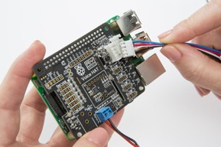
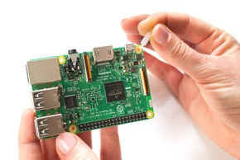
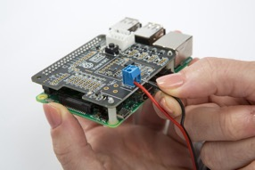
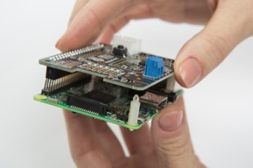
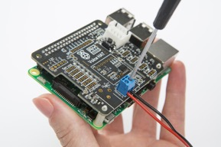
Assemble the Hardware
Parts Required: Raspberry Pi 3, Standoffs (2x), Voice HAT Board, Speaker, 5 Wire Daughter Cable
1) Insert the two plastic Standoffs into the Raspberry Pi 3’s yellow holes opposite the 40-pin box. Gently press the Voice HAT Board and attach it to the Raspberry Pi, connecting the 40-pins and the two Standoffs.
2) Plug the Speaker cables into the Voice HAT Board (blue block on board). Connect the red wire to the positive (+) terminal, and the black wire to the negative (-) terminal. Screw the wires in place and gently tug to ensure they are secure.
3) Insert the 4-Wire Button Cable (white port on one end, four separate wires on the other) into the white connector labeled “Button” on the Voice HAT Board.

Slide 10
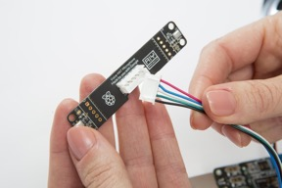
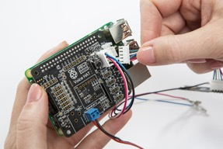
Assemble the Hardware - Continued…
4) Connect the 5 Wire Daughter Cable to the Voice HAT Microphone Board. Both ends of the cable are the same.
5) Plug the other end of the 5-Wire Daughter Cable to the Voice HAT Board using the white connector labeled “Mic”.

Slide 11
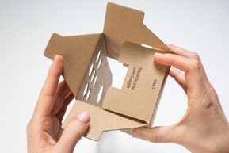
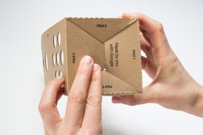
Build The Outer Box
Parts Required: External Box
1) Fold along the creases to make a double ended open box, then find the side with four flaps. Fold down the flap labeled “Fold 1”.
2) Fold the remaining flaps in order, tucking the end of Fold 4 under Fold 1.

Slide 12
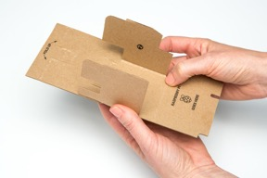
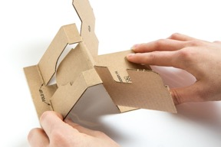
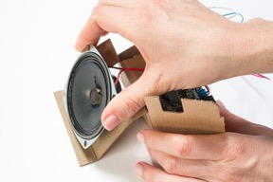
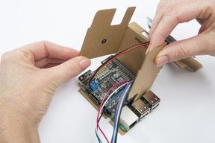
Build the Inner Frame
Parts Required: Inner Frame
1) Fold flaps 1 and 2 along the creases. Push the U-shape portion of the flap above flaps 1 and 2 out. Fold the bottom flap (below flaps 1 and 2) at the crease to create a base.
2) Fold the section labeled “Fold Up” so that it’s flush with the table. There is a notch that folds behind the U-Shape flap to hold it in place. The U-shaped flap should lay flush with the box side.
3) Slide the speaker into the U-Shaped pocket on the cardboard frame. Next, take the Raspberry PI and Voice HAT combo and slide it into the bottom of the frame below flaps 1 and 2 (as shown below). The USB ports should be exposed from the frame.

Slide 13
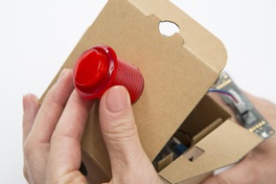
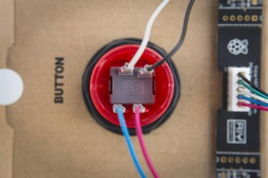
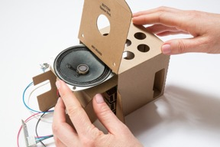
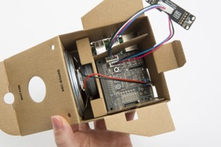
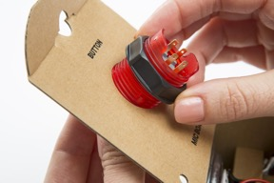
Put it All Together
Note: If your SD card is already inserted into the PI, remove it before continuing.
1) Take the outer box and set it on its back with the circular speaker holes facing up. Slide the cardboard frame and hardware into the box with the speaker facing upward. Place the outer box on its bottom side, and ensure all cables are still plugged in.
2) Insert the Button into the top of the outer box and tighten it with the washer.
3) Looking at the Button, locate the crown icon. With the base of the crown facing you, insert the wires as follows:
Blue: Bottom Left
Red: Bottom Right
Black: Top Right
Blue: Top Left

Slide 14
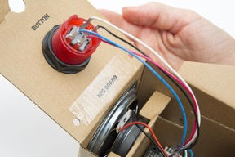
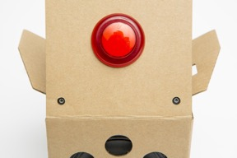
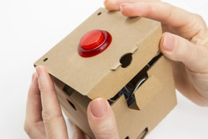
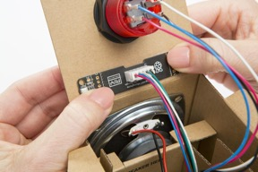
Put it All Together
4) Place a piece of double-sided tape onto the outer box’s top flap where it says “Mic Board”. Line up the microphone board so the mics (white boxes on the ends) are sitting aligned with the holes and firmly push.
5) Check the outside of the top flap to ensure the microphones are aligned properly.
6) Close the box, well done!

Slide 15
AIY Vision Kit

Slide 16
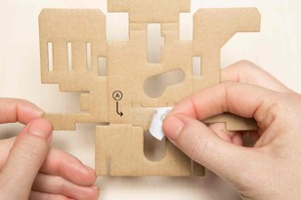
Fold the Internal Frame
Parts Required: Internal Frame, Raspberry Pi Camera V2, Long Flex, Piezo Buzzer
1a) Open the cable connector latch on the camera by pulling back gently on the black raised latch.
1b) Insert the wide end of the flex cable until it hits the back of the connector with the copper stripes facing away from you.
1c) Close the cable connector latch by pressing down. You should feel the latch snap into place. Gently check that the cable is secure.
2) Take the Internal Frame as shown, and remove the adhesive liner.

Slide 17
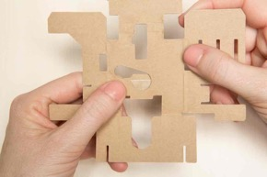
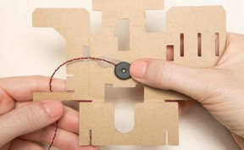
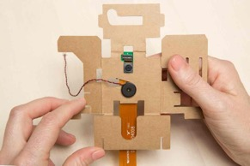
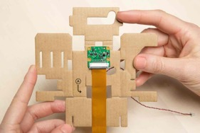
Fold the Internal Frame - Continued…
3) Fold the adhesive flap and press firmly.
5) Orient the buzzer so that its wiring follows the opening as shown below. Press the buzzer firmly to the adhesive tab.
6 ) Grab the camera assembled in step 1 and peel back the clear sticker off the lens. Place the camera board aperture into the rectangular slot in the middle of the board with the lens facing you (first picture). Flip the frame over and verify placement (second picture).
4) Rotate the frame over as shown

Slide 18
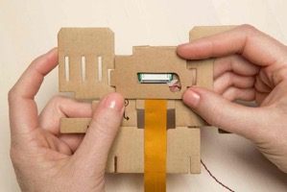
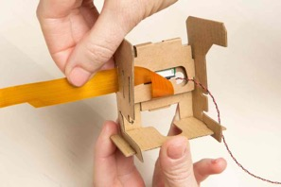
Fold the Internal Frame - Continued…
7) Fold down the top flap over the camera board, and fold the left and right flaps up toward you to hold the camera in place.
8) Thread the buzzer wire through the circular opening next to the Long Flex, and fold the Long Flex up and crease it by pressing gently.
9) Fold the Long Flex to the left at a 45-degree angle. The unconnected end of the cable should align with the three slits to the left. Next, thread the Long Flex through the bottom slit (furthest from you), ensuring the copper lines are facing away from you.

Slide 19
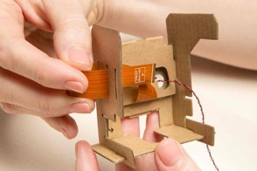
Fold the Internal Frame - Continued…
10) Moving to the middle slit, thread the cable back through to the middle of the frame.
11) Then, thread the Long Flex through the final slit. The cable should be threaded through all three slits, and sticking out of the left side of the frame.
This completes the internal frame for now…ready to connect some boards?

Slide 20
Connect the Boards
Parts Required: Raspberry Pi, Vision Bonnet, 2x Standoffs, Short Flex, Button Harness
1) Orient the Raspberry Pi so that the 40-pin header is on the left edge, and open the top cable connector. Be sure to hold the edges of the board when doing so to reduce the risk of damage. Insert the Short Flex’s “Rasp Pi” labeled end into the connector, with the copper stripes facing away from you, and close the latch.
2) Orient the Vision Bonnet so the 40-pin header connector is on the bottom and the white connector is at the right. Flip open the connector, and insert the unconnected end of the Short Flex (labeled Vision Bonnet). Close the connector, ensuring the copper stripes are still facing away from you.
3) Insert the standoffs into the Raspberry Pi board in the holes opposite the pin header. Note you may need to apply some force to get them in. If you feel you are applying too much force and cannot insert the Standoffs, you can use pliers or another tool to squeeze the end of the Standoffs while inserting.

Slide 21
Connect the Boards - Continued…
4) Align the Vision Bonnet connector with the pin header on the Raspberry Pi.
5) Push the Short Flex inward into the space between the two boards.
6) Firmly push the boards together to snap the standoffs into place. Additionally, push from the center of the connectors to ensure they are firmly inserted.

Slide 22
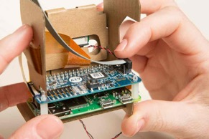
Add Boards to the Internal Frame
Parts Required: Assembled boards, Button Harness, and Internal Frame
1) Align the boards with the Vision Bonnet facing you, and connect the Long Flex into the white connector with the copper stripes facing away from you.
2) With the Vision Bonnet (blue) on top, slide the boards into the slots that look like a mouth. Lightly crease the twisted part of the Long Flex so that is lays closer against the board.
3) Connect the Button Harness to the right side of the Vision Bonnet. Note, it does not matter which end of the Button Harness you plug in.

Slide 23
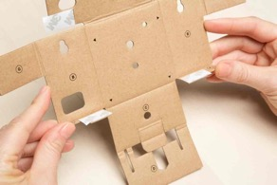
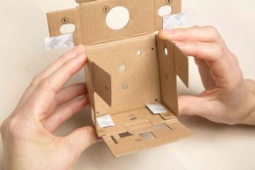
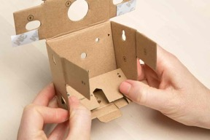
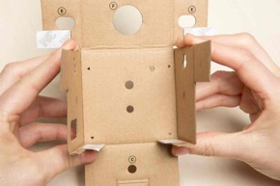
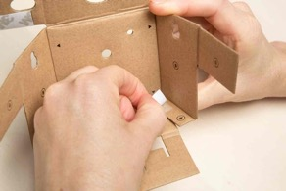
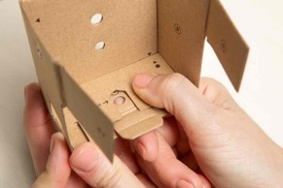
Build the Box
Parts Required: External Box and Tripod Nut
1) Orient the box so the lettered labels are facing you. Fold each of the tabs labeled A upward, and each of the B tabs toward you.
2) While holding tabs A and B, fold tab C upward toward you. Once folded, peel the adhesive liners off of the A tabs.
3) Fold tab D up and press it firmly down on the adhesive. The arrows should line up as shown below.

Slide 24
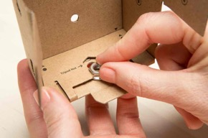
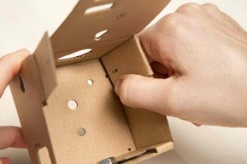
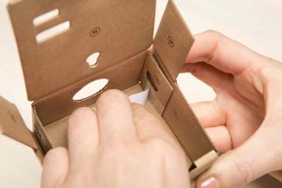
Build the Box - Continued…
4) Take the Tripod Nut and slide it, wider side down, into the slot labeled Tripod Nut.
5) Fold the flaps labeled E inward, and the flaps labeled F upward. Remove the adhesive on the E flaps.
6) Fold over the G flaps and press firmly onto the adhesive on the E flaps. Arrows should align as shown below.

Slide 25
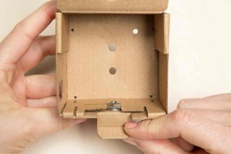
Build the Box - Continued…
7) Fold down the bottom retaining flap. It has a crease in the center, fold the crease towards you.
8) Fold down flap H, your box is complete!

Slide 26
Bring it together
Parts Required: Completed External Box and Internal Frame
1) Take the internal frame and slide it into the back of the External Box
2) Ensure that your Raspberry Pi and Vision Bonnet board are still sitting snugly in the Inner Frame and that your Flex Cable is secure. Also check that the camera is visible through the camera hole on the other side of your box.

Slide 27
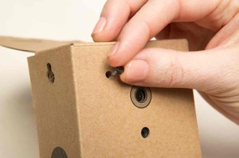
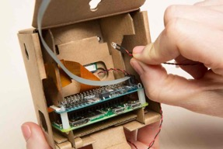
Install the LED
Parts Required: LED, LED Bezel
1) Turn the box around where you will see three holes. Push the LED Bezel into the upper left hole above the camera.
2) Turn the box around. Take the Privacy LED and insert the end with the bulb into the LED Bezel you just installed. It should snap into place.
3) Make sure the Privacy LED is peeking out on the other side.

Slide 28
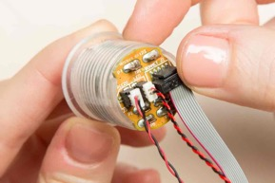
Install the Final Hardware
Parts Required: Push Button, Button Nut
1) Gather the Piezo Buzzer, Privacy LED, and Button Harness cables. Thread all three through the Button Nut. The wider side of the Button Nut should be facing upwards, toward the top of the box. Thread the cables through the top of the box.
2) Hold the push button upside down, and plug in the Buzzer cable into the port labeled PIEZO, the privacy LED into the LED port, and the Button Harness into the black connector to the right. Insert the push button into the hole.
3) From inside of the box, screw the Button Nut to secure the Push Button, close the box, and insert the SD card.

Slide 29
Connect To Your Kit

Slide 30
Connecting to Wi-Fi
Connect your laptop to the hotspot:
If you’re using a provided kit, it will automatically connect to the same hotspot.
Network: Build Night
Password: Travelers

Slide 31

Connect to Your Kit
Prerequisite: install VNC Viewer.
Open VNC Viewer and enter your host name address followed by “.local” (EX: applepi.local). Your host name can be found on your kit.
Enter the password “Travelers”
You will now be connected to your device.

Slide 32

Verify The Build
To verify your build, double click the “Check audio” file on the desktop of the device. A terminal window will open and a script will being to run. First, you will hear a sound from the speaker, confirm you have heard it by pressing “y”. Second, repeat the phrase shown on the screen and verify you heard your own voice in return. Once complete, you have verified your device is functioning properly.

Slide 33


Run Custom Code
NOTE: This uses the custom text message example from GitHub. You can navigate to the repository and copy the file contents to your clipboard.
1) First, on the device open the file explorer and navigate to the folder /home/pi/AIY-projects-python/src/examples/voice
2) Right click in the explorer window and choose “Create New -> Empty File” and name it whatever you would like (in this example text_message.py)

Slide 34


Run Custom Code Continued…
3) Right click the new file and choose “Thonny Python IDE” to open the file. The Thonny editor will open with an empty file.
2) Paste the code you would like to run into the window (or manually write it if custom). Save the file, then click the green play button to run the script.

Slide 35

Run Some Code
3) If using the text message example, you will now be able to tell the kit to send a text message by saying “OK, Google send text message”.

